Slide 1
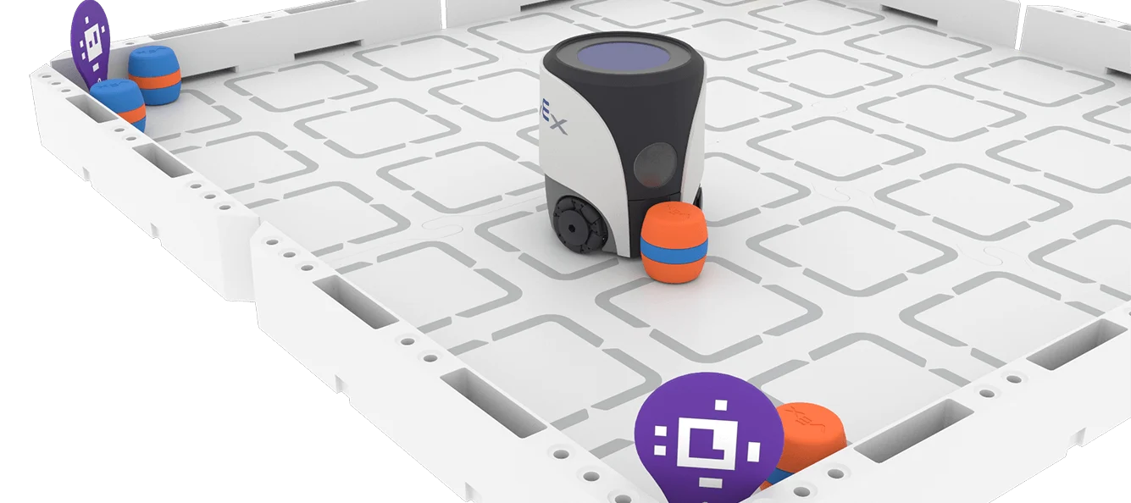
RECORDING MY LEARNING JOURNEY
STUDENT NAME: Noah_______________
YEAR 9 STEM DIGITAL
PORTFOLIO

Slide 2
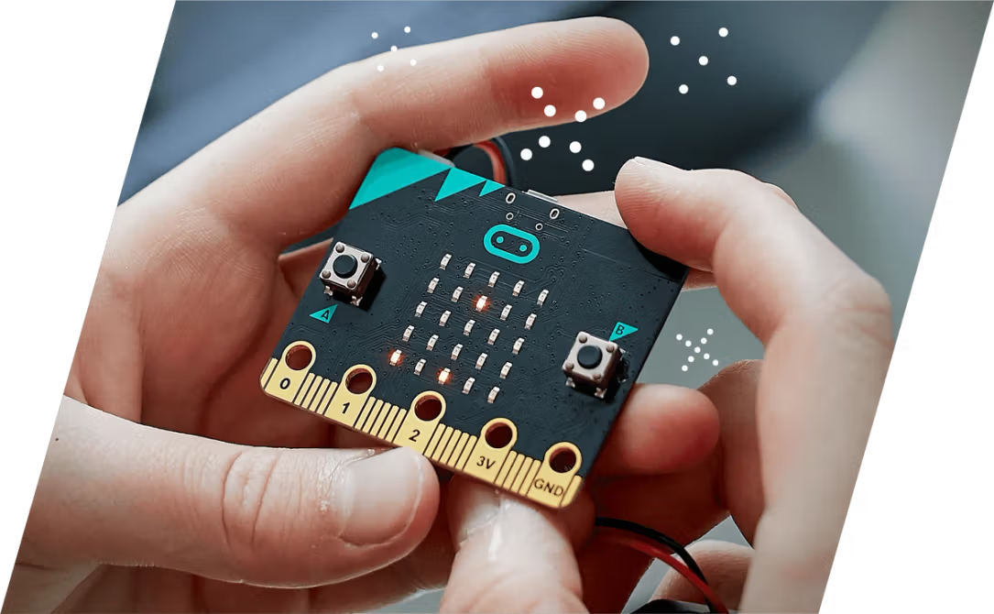
MY ROBOTICS EXPERIENCE
Year 7 and 8 digital makers
.Block Coding
.Micro Bits
.Made and Coded a Useless Box
Scratch Jr and Scratch in Primary School (made games)
Made an arcade in Journeys

Slide 3

WHAT I HOPE TO LEARN
I hope to learn how to code a robot to learn on its own
I hope to learn how to build effective things for different purposes

Slide 4

UNIT GUIDE
HOW TO USE EACH UNIT
WHAT YOU WILL DOCUMENT
TIPS FOR SUCCESS
Each unit slide includes the same prompts to help you document your learning consistently. Fill in each section as you work through the unit activities.
Delete the prompts once each section is completed.
Add more slides as required.
Each unit includes: What I Learned, Key Vocabulary (3-5 terms), Code & Programming Notes, Challenges & Solutions, Pros & Cons, and Reflection Questions. Complete each section after finishing the unit activities.
Use your own words. Include screenshots or sketches where possible. Be honest in your reflections. Ask your teacher if you are unsure what to write in any section.

Slide 5
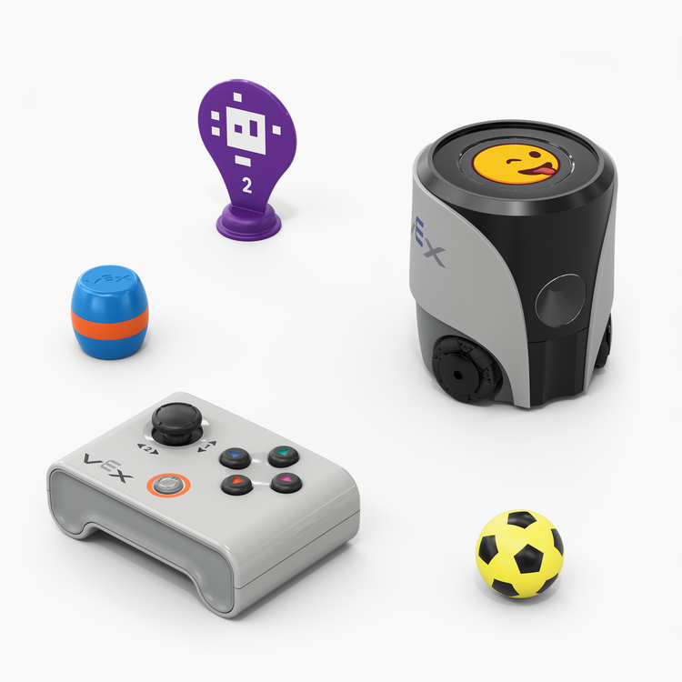

UNIT 1 – DRIVE WITH A CONTROLLER
Add an annotated image of the remote that explains how to use it.
Joystick: Controls movement and rotation. The further you move it the faster the bot goes
Down Button: Kicks

Slide 6
UNIT 1 – DRIVE WITH A CONTROLLER
CHALLENGES & SOLUTIONS
Being able to control the direction and pace of the bot was very challenging but with patience and time we were able to work with it fluently.
PROS & CONS OF USING A REMOTE
Pros: You have total control when things go wrong
Cons: It takes a lot of focus and effort
REFLECTION
It was interesting to drive around the robot; I look forward to coding it.
WHAT I LEARNED
Controller
Messages
Movement
Code
AI Vision
Pairing
April Tags

Slide 7
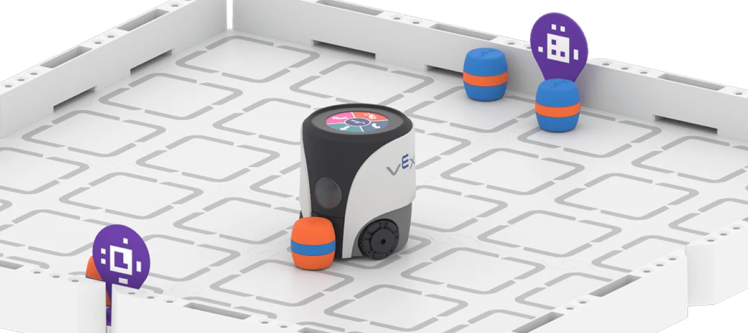
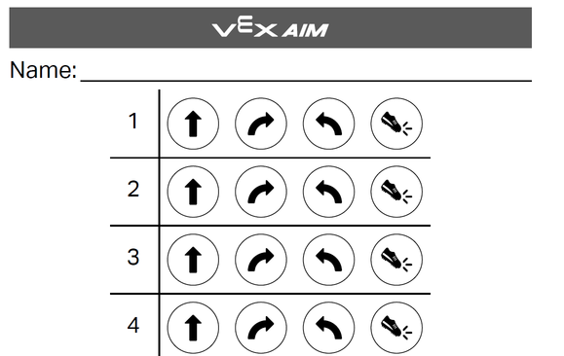
UNIT 2 – TOUCH TO CODE
WHAT I LEARNED
You need to enter a sequence using four different commands to make the bot do what you want.
KEY VOCABULARY
• Button Event / Trigger: A button event is an action or occurrence detected by a system or software when a user interacts with a physical or digital button.
• Command Sequence: A command sequence is an ordered list of instructions or actions that a computer system, program, or machine executes one after another in a specific order
CODE / PROGRAMMING NOTES
• Button used: Forward, Turn, Kick
• Robot action triggered: Robot moved 3 inches, turned 90 degrees and kicked the barrel
CHALLENGES & SOLUTIONS
• Challenge I faced: Being able to code without mistake
• How I solved it: undoing everything and trying again
.
REFLECTION
• What surprised me about button coding? It was non-time consuming
• How did planning my sequence help? It allowed me to code without mistake
• What would I improve next time? The amount of inputs
PROS & CONS OF BUTTON CODING
Pros: Hands free movement
Cons: You can’t change the command if something goes wrong (no if)

Slide 8
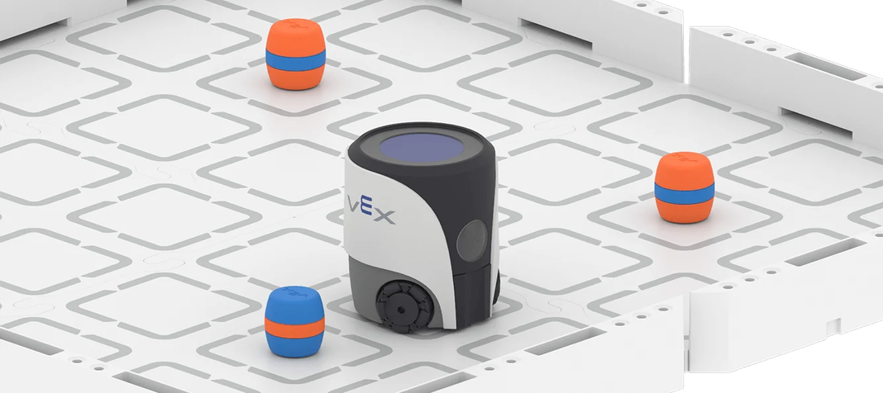
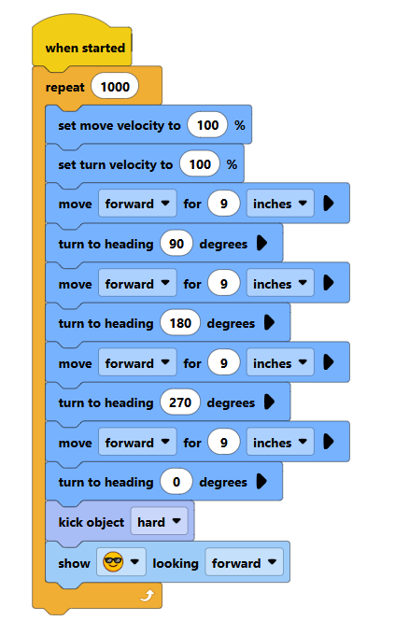
UNIT 3 – MOVE AROUND OBSTACLES
WHAT I LEARNED
I got the robot to move by uses the block codes move forward by distance and rotation by degrees
KEY VOCABULARY
• Block code • Obstacle detection • Loop • Conditional • Sensor input
PROS & CONS OF BLOCK CODING
Pros: Easy to read and change
Cons: Limited if buttons available
CHALLENGES & SOLUTIONS
If the coding is slightly off, I needed to alter it

Slide 9
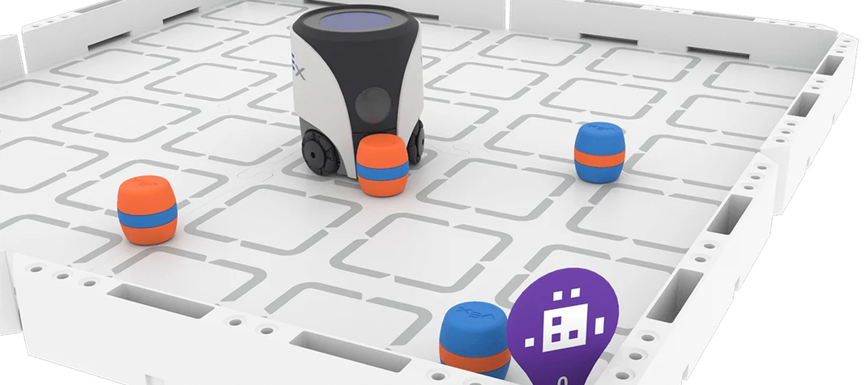
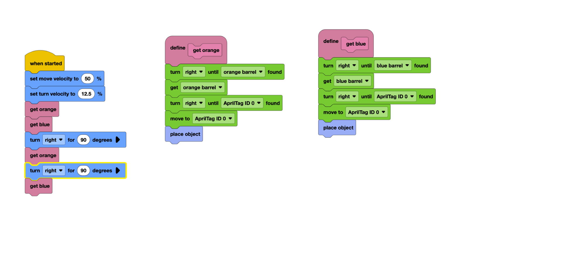
UNIT 5 – TRANSPORT CARGO
We used the ai vision system, It was quite easy to do.
The challenges were making sure it didn’t pick up/detect any barrels that had already been placed>
PROS & CONS OF TURN TO HEADING
Pros: Turns to a heading
Cons: you need to know what the heading is
REFLECTION
I didn’t use heading; I used the AI sensor to do it for me.

Slide 10
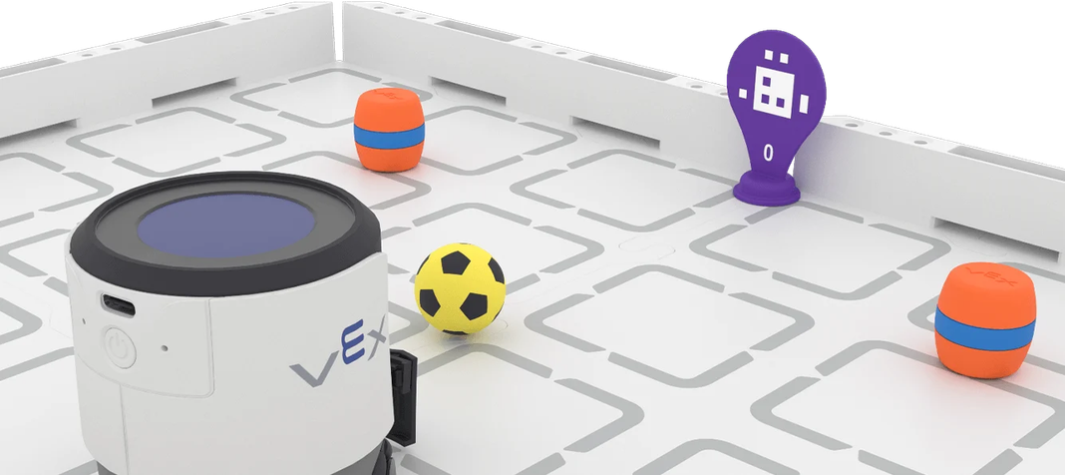
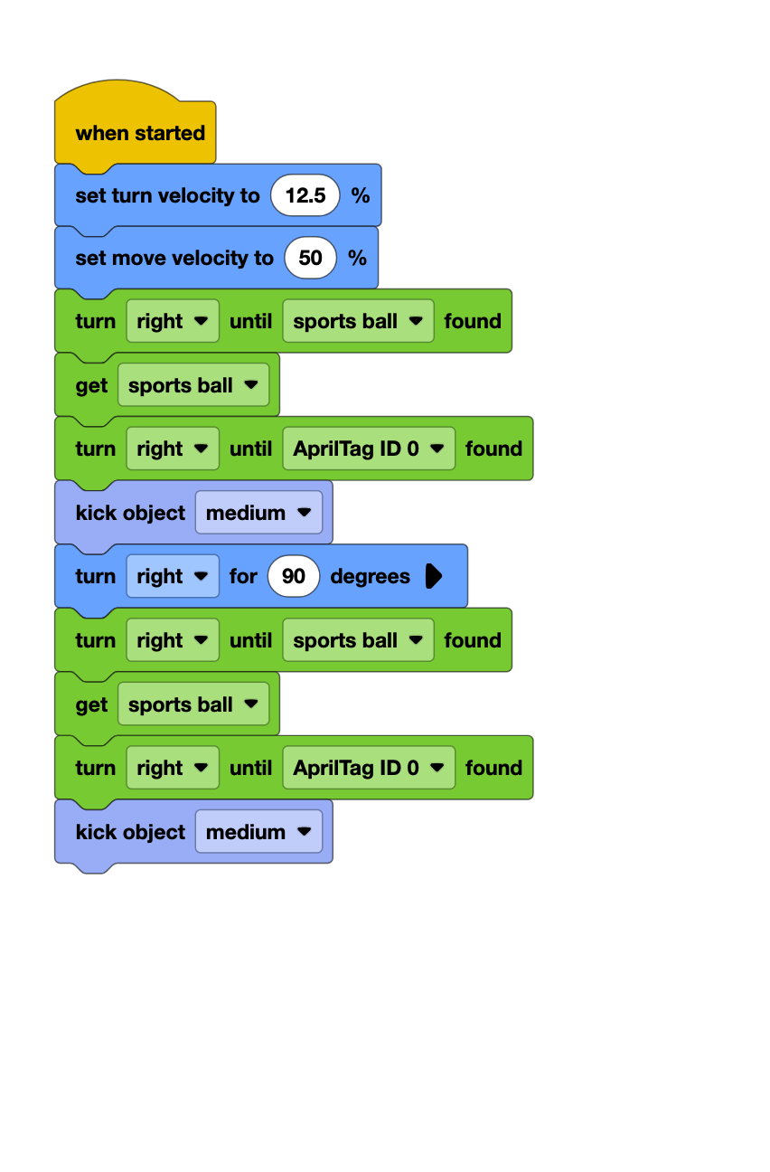
UNIT 6 – FINDING & TRANSPORTING CARGO
The robot uses AI to sense where the ball is, drive to it, find April tag 0 and shoot
Jack overcomplicated things until I pointed out the obvious ☺
REFLECTION
• The program was effective but could not track the ball if it was moving. It had to be stationary

Slide 11
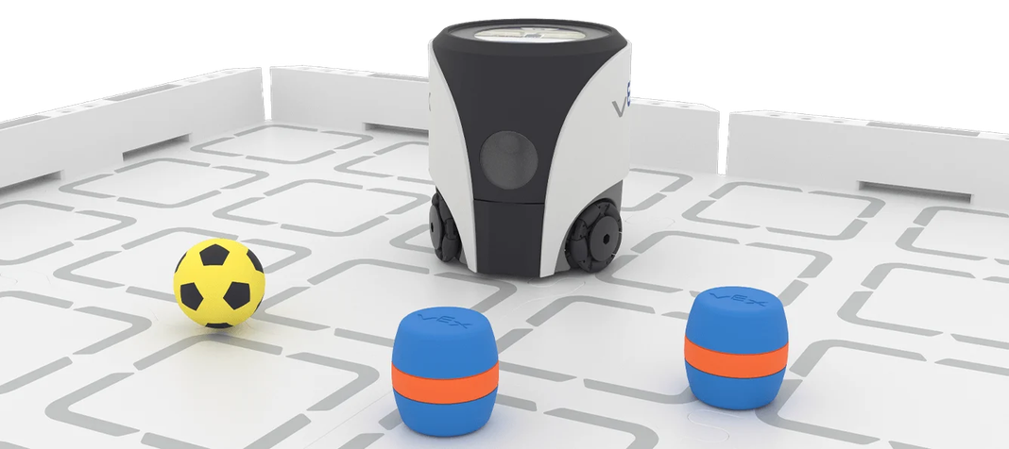
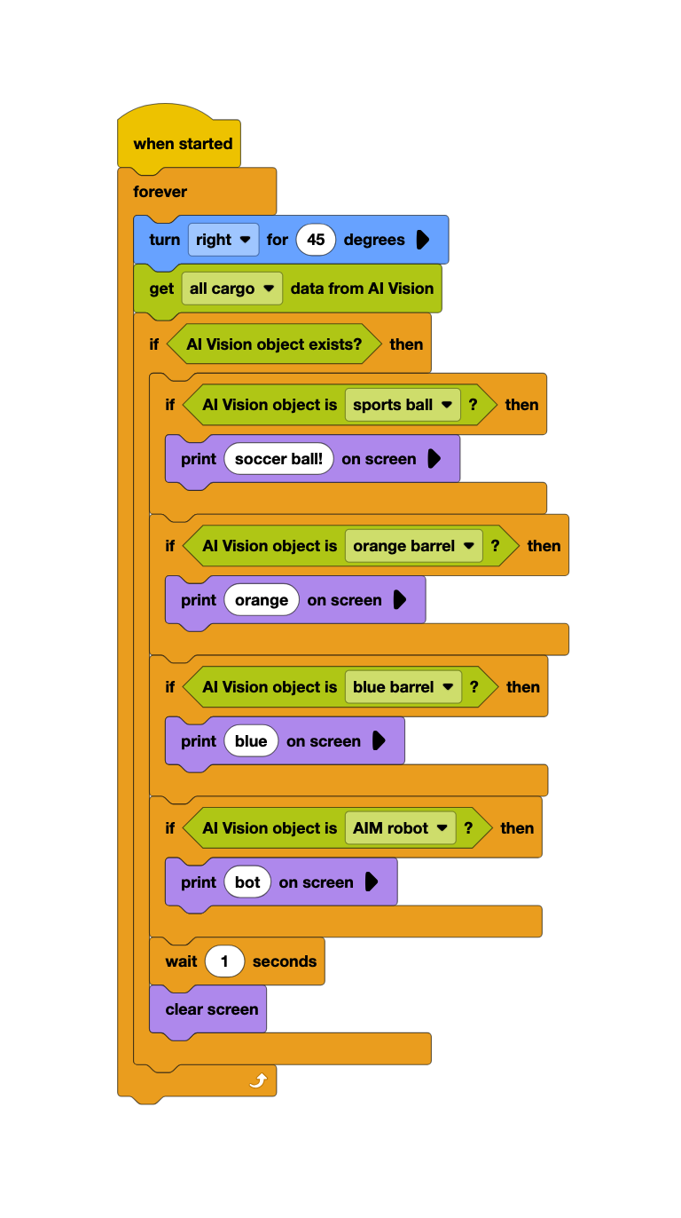
UNIT 7 – EXPLORING AI VISION
WHAT I LEARNED
The AI detects the thing and then it’s coded to respond in a certain way
INVESTIGATION STEPS:
FINDINGS & REFLECTION
The AI vision is pretty good at recognizing the objects, although it fails when the camera or an object is moving.
How it works: The Ai sensor uses snapshots of its surroundings; it uses its proximity to the item and the color and pattern recognition to find an item.
Faults: If the color of an object is slightly off the ai vision won’t pick it up. But a too large of a color spectrum can fault the items validity.

Slide 12
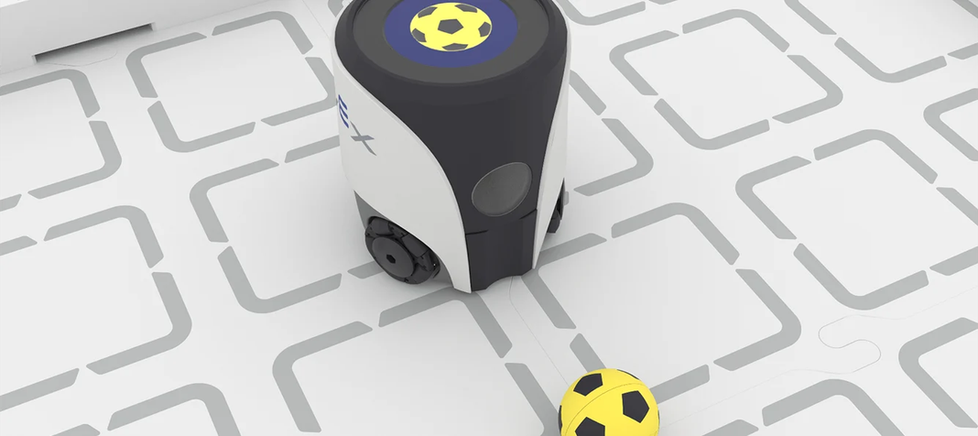
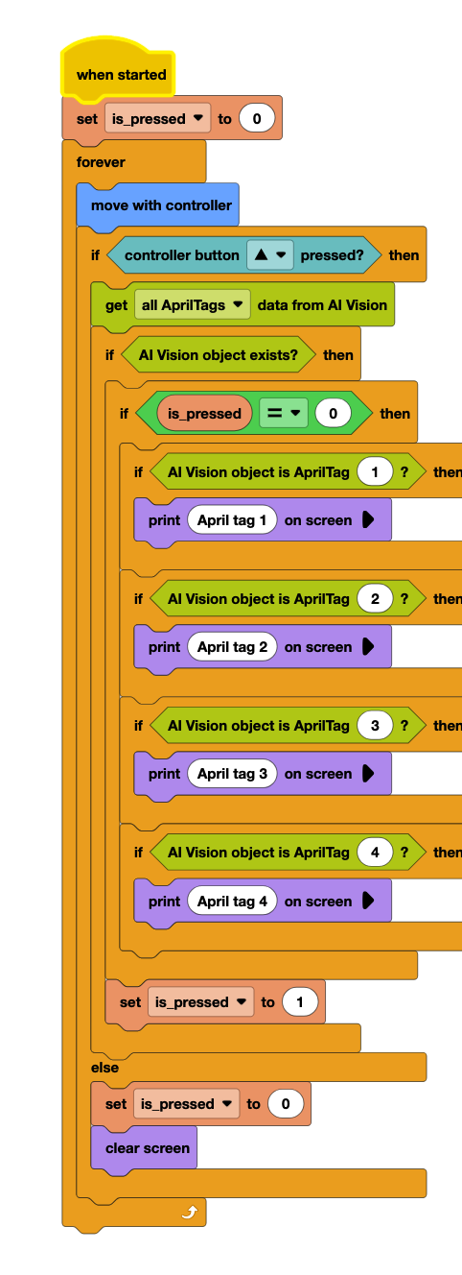
UNIT 8 – CONTROLLING DECISIONS
What I Learned:
I made a set of if conditions, it checked if the up button was pressed and if anything was detected with the ai vision sensor, if both were true the it would display text saying what it saw. If it saw nothing it would say nothing
Capstone Preparation Reflection:
My biggest strength is the ability to find problems with the code and solve them, as well as creating simpler code for the job.

Slide 13

DELIVERY DASH
CAPSTONE CHALLENGE – PLANNING
Project Goal: To sort registered cargo to certain locations
My Approach / Strategy: Check the loading bay, if there is something then take it to the correct point
Steps I Plan to Take: Check cargo bays, work out what the object is, determine the correct zone, move the item to the repeat, reverse and repeat.
Resources / Code I Will Use: I will use the ai vision sensor to find objects and April tags
Potential Challenges: Loading cargo to the wrong zones or picking up the same cargo twice

Slide 14
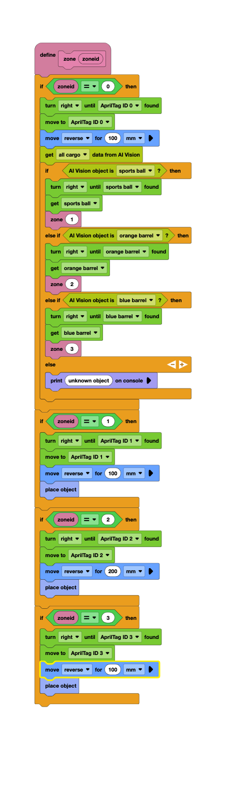
DELIVERY DASH
EXECUTION & CODING
RESULTS & REFLECTION
Outcomes & robot performance: The robot successfully delivered all objects. The robot would sometimes deliver the same object twice
What went well: the robot found and delivered all objects.
Lessons learned & improvements for next time: The robot can’t handle any cargo left on the board after delivery

Slide 15
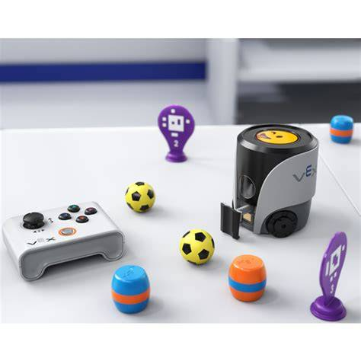
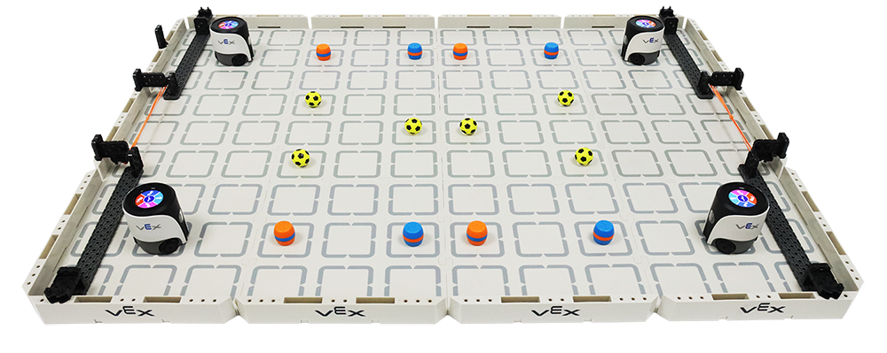
SHOWCASE PLANNING
DEMO ACTIVITY
MATERIALS NEEDED
Activity Description:
Demonstrate your VEX Aimbot robot to parents and visitors. Show how your robot navigates, avoids obstacles, and completes tasks using your chosen coding approach.
Step-by-Step Instructions:
  Set up the robot and arena
  Explain your coding method
  Run a live demonstration
  Invite visitors to try the controller
  Answer questions about your learning
Materials Checklist:
• VEX Aimbot robot (charged)
• Remote controller
• Laptop with VEX coding environment
• Arena/obstacle course setup
• Printed program or cue cards
Expected Learning Outcomes:
Visitors will understand how students use block code, AI vision, and remote control to program autonomous and manual robot behaviours in real-world challenges.

Slide 16

SHOWCASE CODING OPTIONS
REMOTES: MANUAL CONTROL
BUTTON CODING: INTERACTIVE TRIGGERS
BLOCK CODE: AUTOMATED SCRIPTS
Use a controller to drive the robot live during the demo. Great for showing visitors how to steer and interact with the robot in real time. Simple, engaging, and easy to explain to parents and guests.
Program specific buttons to trigger robot actions. Visitors can press a button and watch the robot respond. A great way to show how simple inputs create programmed outputs and introduce coding logic.
Set up a fully automated sequence using block code. The robot runs a pre-programmed routine independently. Ideal for demonstrating autonomous navigation, obstacle avoidance, or cargo transport without manual input.

Slide 17
OVERALL UNIT REFLECTION
MY LEARNING SUMMARY
🏆 My biggest achievement:
💡 Challenges I overcame:
🤖 How my understanding improved:
🚀 Skills I'll take forward:

Slide 18
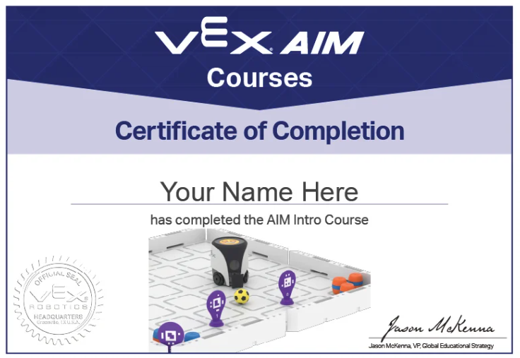

Slide 19
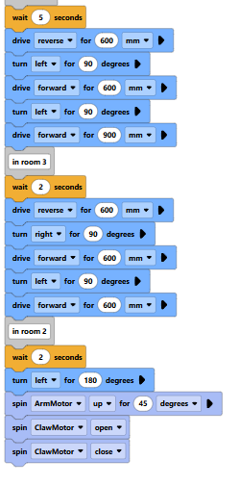
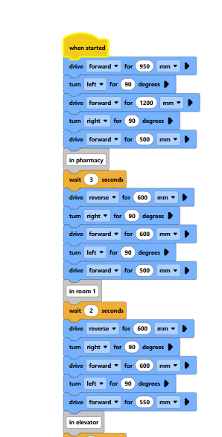
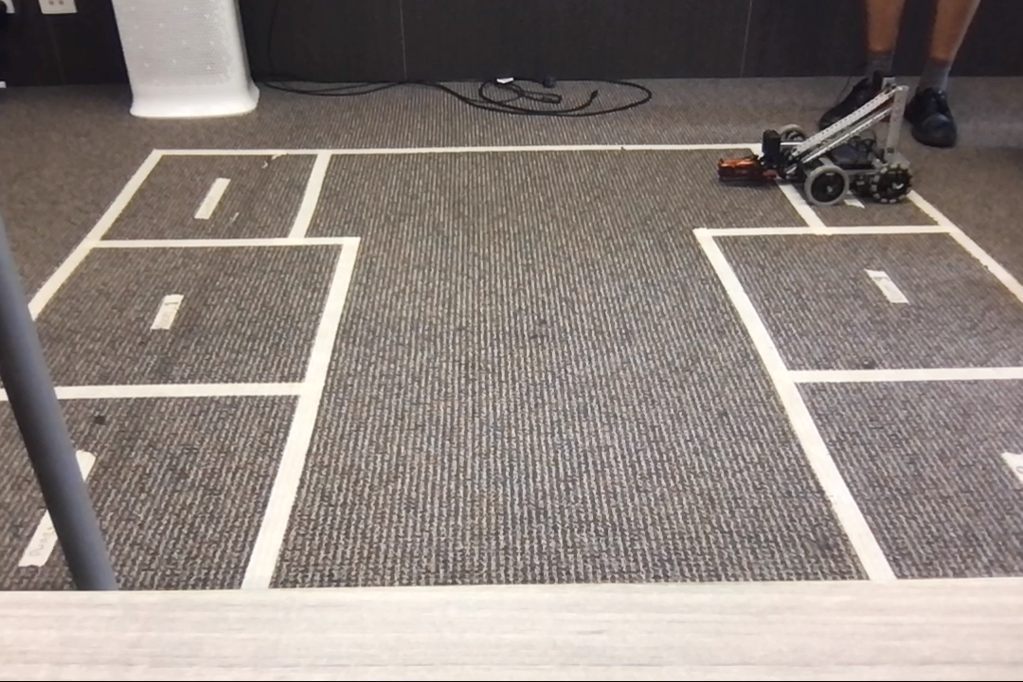
Medi-bot Challenge
Reflection: The coding wasn't too difficult. The hardest part was finding exact measurements and dealing with a faulty inertia sensor.
This was a fun challenge but brings up whether or not robots in medicine is ethical.

